Slide 1
DRILLING PROJECT
MANAGEMENT

Slide 2
Kementrian DPM - JDS
Menteri: IBAK (+62 812-8829-9918)
Wakil Menteri: Santika (+62 819-5500-219)
Satgas#1 Kelompok DPM & Mentor:
Febri (+62 815-9003-500)
Icha (+62 811-1249-409)
Satgas#2 Diskusi & Presentasi Kelompok
Febdi (+62 811-101-541)
Rafli (+62 857-7587-9267)

Slide 3
Content
Introduction to Project Management & Drilling Project Management
Modul-1 JDS Project Initiation

Slide 4


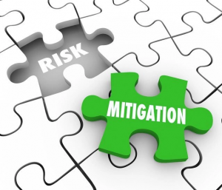

What is Project Management?
Project Management is the application of knowledge, skills, tools, and techniques to project activities to meet the project requirements."
Integration
Connecting thousands of small details into one cohesive whole.
Leadership
Setting the direction and keeping the team on path to the goal.
Risk Mitigation
Anticipating the storm before it arrives at the worksite.
Value Creation
Ensuring every cent spent delivers a result for the company.

Slide 5
Why do we need PM?
(The Order from Chaos)
Without Project Management, a drilling project will likely suffer from:
Scope Creep: Work expanding without direction.
Budget Overrun: Costs swelling beyond the AFE.
Missed Deadlines: Wasted time on the rig floor.
Chaotic Communication: Miscoordination between vendors and the team.
Key Message: "PM brings ORDER to CHAOS. It transitions us from being reactive (putting out fires) to being proactive (preventing the fire from starting)."

Slide 6
Triple Constraint
Scope: What work is being done? (Depth, logging program, completion).
Time: How long will it take? (Days vs. Depth, Rig release date).
Cost: What is the budget? (AFE, daily spread rate).
QUALITY
SCHEDULE
COST
SCOPE
A change in one constraint inevitably impacts the other two. Quality is the result of balancing these three

Slide 7
Project Life Cycle
PROJECT
INITIATION
PROJECT
COMPLETION
PROJECT
PLANNING
PROJECT
EXECUTION & MONITORING

Slide 8
Exercise : Provide Simple Project

Slide 9
Wedding Party
Project Phase | Analogy
Initiation | Decision to marriage, Rough Budget Estimate.
Planning | Venue decision, Catering Services decision, Wedding Organizer, Invitation letter, etc.
Execution & Monitoring | D-Day (Resepsi/Akad Nikah).
Completion | Final Invoicing & Vendor Evaluation
* Imagine if the catering didn't show up (Operational Risk) or the venue wasn't paid off (AFE Overrun)

Slide 10
Why PM Matters in Drilling?

Slide 11
DPM as "The Art of Integration"
In drilling, the Project Manager is the "glue" that holds dozens of specialized service companies and internal departments together.
The Concept: Drilling involves coordinating 30+ vendors (mud, logging, cementing, etc.) simultaneously.
The Key Message: DPM is about ensuring that Subsurface, Engineering, Procurement, and Operations are perfectly aligned

Slide 12
Managing "Subsurface Uncertainty"
Unlike a construction project where you can see the worksite, drilling happens thousands of feet underground in an invisible environment.
The Concept: We rely on probabilistic models (P10, P50, P90) because we cannot see the target directly.
The Key Message: DPM is not just about following a plan; it is about managing the risks of geological "surprises" like pressure anomalies or hazardous gases

Slide 13
Value Protection (NPT & ILT)
In other industries, a delay might just be an annoyance. In drilling, "Time is Money" is a literal, expensive truth.
The Concept: Every hour of Non-Productive Time (NPT) or Invisible Lost Time (ILT) can burn thousands of dollars in rig spread rates.
The Key Message: The Project Manager’s primary goal is to protect the investment by ensuring every minute on the rig floor is productive and safe

Slide 14
Project Life Cycle - DPM
PROJECT INITIATION
Project Scope
Risk Assessment project
Project Economical
PROJECT PLANNING
Drilling Basis of Design
Project timeline
Detail Budget / AFE
Risk Register
Logistic & Supply chain plan
Procurement Strategy
Well Control Plan
Emergency & Contingency Plan
PROJECT EXECUTION & MONITORING
Drilling Program
Bridging document
DWOP (Drilling Well on Paper)
Bill of Material (BOM)
Daily Drilling Report (DDR) & NPT/ILT Tracking
Cost & Contract Monitoring
PROJECT COMPLETION
End of Well report
Drilling Post Mortem
Well Performance Analysis
After Action Review
Service Quality Meeting
Financial Close Out

Slide 15
Application in Drilling
Managing Subsurface Uncertainty: Unlike construction, we cannot see our "worksite" clearly. We manage geological risks using probabilistic models (P10, P50, P90).
The Stakeholder Landscape: Managing relationships with Regulators (SKK Migas), Partners, Service Companies, and Local Communities.
The Cost of Inefficiency: In drilling, "Time is Money" is literal. Every hour of NPT (Non-Productive Time) can cost thousands of dollars.
Risk-Based Decision Making: Using Decision Gates to ensure the project only proceeds if it remains safe and economically viable

Slide 16
Project Management Team
Role | Main Responsibility
Project Manager (PM) | Document Integrity, Decision Tree, Team Coordination, Milestone Tracking
Subsurface Specialist | G&G Analysis, Coordinate Target, PPFG profiles, Offset Well Data Validation
Drilling Design Engineer | Well Architecture Design, Rig Selection, Trajectory design, Drilling Program Text
Risk & HSE Engineer | Hazard Identification, Risk Matrix, Contingency/Emergency Plan, HSE Bridging document
Project Contract & Economist | Cost Estimation (Dry Hole vs Complete), Spread Rate calculation, Final AFE Cost, Invoice Reconciliation
Logistic Coordinator | Material Tracking (LLI), Rig Move Logistics, Personnel & Equipment Mobilization, Vendor Supply Chain Alignment

Slide 17
Break – 10 minutes

Slide 18
PROJECT INITIATION

Slide 19
Project Initiation
Laying the Strategic and Economic Foundation for Advance Drilling Operations and Value Creation
Establish the “Why” and “How” Before the first bit touches the ground

Slide 20

Core Objectives
Technical Feasibility: Validating if the geological target can be safely reached with current technology
Economic Viability: Ensuring the cost of drilling justifies the potential hydrocarbon recovery
Strategic Alignment: Confirming the project fits into the company’s long-term energy portfolio

Slide 21
Defining Project Scope
Technical Boundaries
Establishing precise surface and subsurface coordinates, target formations, and depth parameters (TVD/MD) to prevent scope creep during planning
Major Deliverables
Defining the “End State” of the project: Data Sets (Logging/Coring), Well Test result, and the final status (Producer or P&A)

Slide 22



Macro Risk Assessment
Subsurface
Assessing geological uncertainties like pressure anomalies, faulting, and hazardous gas zones
Operational
Evaluating Rig availability, Lead times material, and logistical accessibility to remote sites
Regulatory
Ensuring compliance with SKK Migas permits, environmental licenses, and social impact requirements

Slide 23
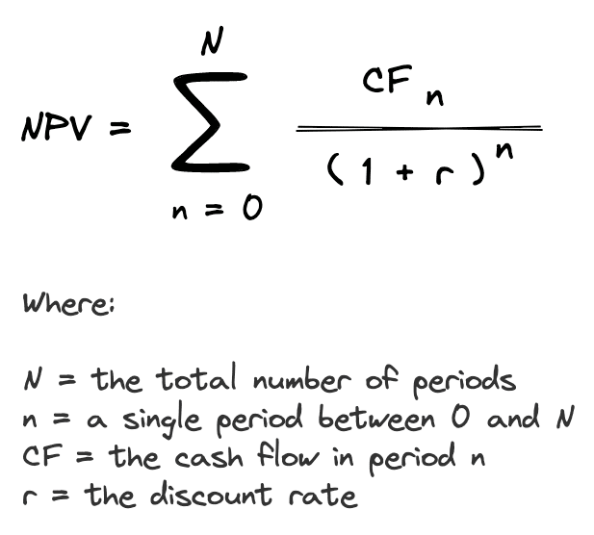
Financial Target
Investment Threshold
A Project must exceed the Weighted Average Cost of Capital (WACC).Initiation focuses on high-level NPV modeling and Payback Period Estimation
25%
Target IRR

Slide 24
Resource Probability Matrix
Confidence Level | Metric | Est. Reserves (MMBOE) | Cost-Reward Ratio
P90 (Proven) | Conservative | 1.2-1.5 | Low Risk / High Stability
P50 (Probable) | Base Case | 2.8-3.2 | Optimal Strategic Target
P10 (Possible) | Upside | 5.5-7.0 | High Reward / Exploratory

Slide 25
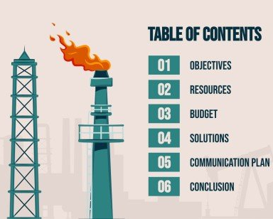
Drilling Proposal
The definitive outcome of Phase-1. It synthesizes all technical and commercial findings into a single business case for executive management.
Goal: Secure the initial AFE mandate and move into Phase-2 Planning

Slide 26
Initiation Workflow
Business Case
Identifying the Opportunities or Requirement
Feasibility
Technical & Geological validation study
Economics
Initial AFE estimation and valuation
Approval
Decision Gate 1
Presentation to Board

Slide 27
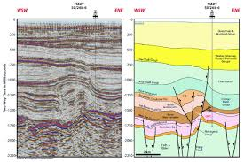
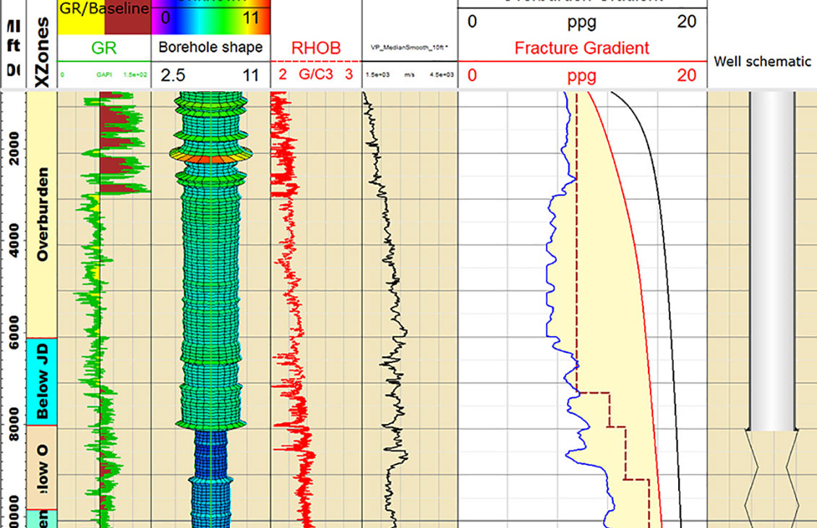
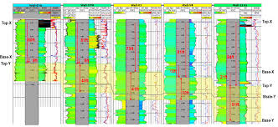
Key Subsurface Inputs
Seismic Interpretation
Pore Pressure Prediction
Offset Well Analysis

Slide 28
Decision Gate 1
The “GO” or “NO-GO” Moment
Moving from Strategic Concept to Detailed Engineering

Slide 29
Q&A
???

Slide 30
PROJECT ASSIGNMENT

Slide 31
Project Assignment
Phase-1 Drilling Proposal
→ Project Approval
Phase-2 Basis of Design
→ Peer Review
Phase-3 Drilling Program
→ DWOP (Drilling Well on Paper)
Phase-4 N/A

Slide 32
PMT Contribution
1. Subsurface Specialist
This role focuses on validating the subsurface targets to ensure the project has a clear and justified objective.
Objective & Feasibility Study Inputs:
  Geological Targets & Rationale: Defines the exact subsurface target coordinates and provides the geological justification (why this specific reservoir structure holds commercial value).
  Preliminary PPFG Profile: Delivers the initial Pore Pressure & Fracture Gradient model. This is the ultimate baseline; if this data is flawed, every engineering design and cost estimate that follows will be wrong.

Slide 33
PMT Contribution
2. Drilling Design Engineer
This role is responsible for translating geological data into a technically safe and executable well construction concept.
Feasibility Study Inputs:
  Conceptual Well Architecture: Translates the Subsurface data into an initial well schematic, defining preliminary casing setting depths and hole sizes.
  Rig Capability Specification: Specifies the minimum rig rating and equipment capacities (hoisting, pump pressure, BOP configuration) required to safely drill the well.
  Technical Feasibility Validation: Proves mathematically that the well can be successfully drilled to the Target Depth (TD) under the expected subsurface conditions.

Slide 34
PMT Contribution
3. Logistic Coordinator
This role performs a reality check on the supply chain and physical access constraints to the project location before capital is approved.
Feasibility Study & Risk Assessment Inputs:
  Macro-Logistics Feasibility: Evaluates the physical accessibility of the location (e.g., terrain restrictions, road/bridge load capacities for heavy rig components, or swamp/offshore marine requirements).
  Long Lead Items (LLI) Supply Chain Risks: Identifies manufacturing and shipping bottlenecks for critical, high-value materials (such as wellheads or specialized casing grades) and provides the realistic Lead Time analysis.
  Market Resource Availability: Assesses whether the required rig type is physically available in the region or if it requires a costly mobilization from another country.
  Initial Mobilization Estimates: Provides the baseline cost figures for massive logistical movements (Rig mobilization/demobilization, trucking convoys, supply vessels) to be integrated into the AFE.

Slide 35
PMT Contribution
4. Risk & HSE Engineer
This role is responsible for mapping all potential hazards and ensuring the project has a robust mitigation framework right from the start.
Risk Assessment Inputs:
  High-Level Risk Register: Audits historical offset well data to identify top subsurface hazards (e.g., shallow gas, severe loss zones, active fault lines) and external liabilities (environmental sensitivities, community issues, land permitting hurdles).
  Risk Impact Matrix: Establishes the probability and severity of each risk, which directly dictates the financial contingency percentage needed in the budget.
  Initial Mitigation Strategy: Outlines the broad safety boundaries and emergency response philosophies to protect the investment.

Slide 36
PMT Contribution
5. Project Contract & Economist
This role delivers the ultimate financial verdict of the proposal, determining if the project makes commercial sense for the company.
Economics Inputs:
  Rough Order of Magnitude (ROM) AFE Cost: Formulates the total estimated capital expenditure (Capex) by integrating rig spread rates, third-party service costs, material costs, and the logistics mobilization budget.
  Financial Viability Metrics: Runs the financial models to calculate NPV (Net Present Value), IRR (Internal Rate of Return), and Payback Period against the estimated reservoir reserves (P50/P10).
  Contingency Allocation: Integrates the financial buffer requested by the Risk Engineer into the commercial model.

Slide 37
PMT Contribution
6. Project Manager (PM)
This role acts as the conductor who synthesizes all disciplines into a single, highly persuasive business case.
Integration & Decision Tree Inputs:
  Document Integrity: Weaves the technical, logistical, safety, and financial inputs into a single, cohesive, and persuasive business narrative for executive approval.
  Macro Decision Tree: Defines the exact operational and financial thresholds for Go / No-Go scenarios, or when to trigger a pre-approved Plan B if subsurface realities shift during initiation.

Slide 38
Drilling Proposal
1. Objective (The Strategic Intent)
The primary goal is to answer: Why are we doing this project and how does it align with company goals?
Required Data: Geological targets, reservoir depth, concession/block status, and production forecasts.
Minimal Content:
  Well Classification: (e.g., Exploration/Wildcat, Appraisal, or Development).
  Project Rationale: Is it to meet national production targets? To prove new reserves? Or to fulfill a firm commitment (KKP)?
  Success Criteria: What defines a "successful well" beyond just reaching the target depth (e.g., specific logging data, DST results).

Slide 39
Drilling Proposal
2. Feasibility Study (The Technical Viability)
The goal is to answer: Is this technically possible with our current technology and rig capacity?
Required Data: Preliminary Pore Pressure/Fracture Gradient (PPFG) models, offset well performance records, and available rig market specifications.
Minimal Content:
  Technical Concept: A high-level description of the well design and why it is suitable for this environment.
  Operational Constraints: Identification of major hurdles (e.g., deepwater, high-pressure zones, remote logistics).
  Capability Assessment: Confirming that the proposed rig and equipment can handle the anticipated subsurface conditions.

Slide 40
Drilling Proposal
3. Risk Assessment (The Threat Mitigation)
The goal is to answer: What could go wrong, and can we survive it?
Required Data: Historical incident reports, geological hazard data (shallow gas, loss zones), and socio-political/environmental regulations.
Minimal Content:
  High-Level Risk Register: Identifying the "Top 5" risks (Geological, Technical, Commercial, and Safety).
  Initial Mitigation Strategy: Broad strokes on how these risks will be managed to protect the investment.
  Project Sensitivity: How a delay or a technical failure would impact the overall project timeline.

Slide 41
Drilling Proposal
4. Economics (The Financial Justification)
The goal is to answer: Is the potential reward worth the capital investment?
Required Data: Rough Order of Magnitude (ROM) Cost Estimate, current oil/gas price forecasts, and estimated ultimate recovery (EUR) based on P90/P50/P10.
Minimal Content:
  AFE Estimate: Total estimated cost (Capex) including a contingency buffer.
  Financial Metrics: Presentation of NPV (Net Present Value), IRR (Internal Rate of Return), and Payback Period.
  Threshold Comparison: Comparison against the company’s WACC (Weighted Average Cost of Capital) or minimum hurdle rate.

Slide 42
Phase-1 Drilling Proposal
Diskusi Kelompok

Slide 43
Back up

Slide 44
Sesi Pagi
Waktu | Durasi | Aktivitas | Detail Konten
08:00 - 08:15 | 15' | Opening & Vision | Sambutan Menteri DPM mengenai standar JDS & pengenalan struktur kabinet.
08:15 - 09:00 | 45' | DPM Fundamentals | Perbedaan Proyek vs Operasi, Triple Constraint, & Lifecycle Pemboran.
09:00 - 09:15 | 15' | Coffee Break | Istirahat sejenak.
09:15 - 10:00 | 45' | Phase 1: Initiation | Membedah Drilling Proposal: Justifikasi teknis, risiko makro, dan keekonomian sumur.

Slide 45
Sesi Siang
Waktu | Durasi | Aktivitas | Detail Konten
13:00 - 13:20 | 20' | PMT Establishment | Workshop: Pembagian 10 posisi kunci dalam kelompok (RACI Matrix).
13:20 - 14:10 | 50' | Drafting Exercise | Diskusi Kelompok: Menyusun draf poin-poin Drilling Proposal didampingi Mentor.
14:10 - 14:50 | 40' | Group Pitching | 3 Kelompok presentasi draf (7' presentasi + 6' feedback dari Menteri/Wamen).
14:50 - 15:00 | 10' | Closing & Mandate | Instruksi pengerjaan dokumen final & info jadwal sidang Gate-1.

Slide 46
Diskusi Kelompok
Berkumpul sesuai kelompok
Diskusi anggota kelompok dan tugas masing-masing anggota
Diskusi mengenai draft Drilling Proposal
Presentasi, perkenalan kelompok + draft drilling proposal yang akan dibuat

